Slide 1
Enfermedades Glomerulares
Prof. Vergottini Ana Soledad
Especialista Medicina Interna / Nefrologia
Coordinadora de INDYEC
2025

Slide 2
Enfermedades Glomerulares
Proteinuria Aislada
Hematuria Aislada
Sindrome Nefrotico
Sindrome Nefritico
GNF rápidamente progresiva

Slide 3
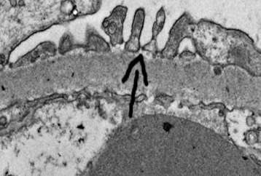
SINDROME NEFRITICO
Hematuria Glomerular ( micro o macro)
Proteinuria
Disminucion TFG _ IRA _Oliguria
Edemas _ Hipertension_

Slide 4
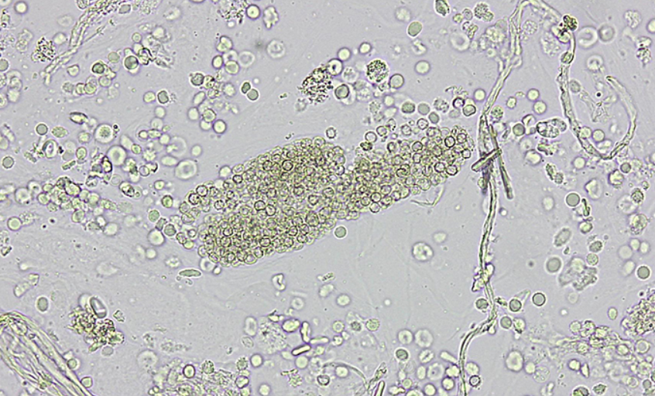

Slide 5
Glomerulonefritis IgA Primaria
Fisiopatogenia :, AUTOINMUNE, IGA1 cadena lambda, activacion via alterna del complemento.
Gnf IgA. Frecuencia.
Masculino (2:1).
Pico incidencia 20-30 años
Sindrome urinario hematuria aislado
Sindrome nefritico
Rapidamente progresiva > Perdida mas 50% tfg en menos de 3 meses y bx crescencias celulares o fibrocelulares>

Slide 6
Secundarias con patron IGA
Chronic liver disease – Mesangial IgA deposition associated with chronic liver disease, particularly alcoholic cirrhosis, is the most common form of secondary IgAN. Despite the frequency of glomerular IgA deposits in advanced liver disease, most adults have no clinical signs of glomerular disease. The urinary abnormalities that may be seen in children typically resolve after successful liver transplantation . Impaired removal of IgA-containing complexes by the Kupffer cells in the liver is thought to predispose to IgA deposition in the kidney. NO HAY ACTIVACION DE COMPLEMENTO.
Enfermedad Celiaca (one-third of patients.). Mayoria asintomatico. No hay activación del complemento.
HIV infection : 8 porciento de los pacientes
MM

Slide 7
Sospechar IgA
Hematuria Macroscopica: 40 - 50 % episodio hematuria visible recurrente acompañando procesos infecciosos de la via aerea superior .
Edad mayor a 40 años, el episodio de hematuria es raro IgA
Microscopic hematuria persistente : 30 _40 percent acompanada o no de algun grado de proteinuria.
Deterioro progresivo TFG
Nephrotic syndrome or rapidly progressive glomerulonephritis – Less than 10 percent present with either nephrotic syndrome or an acute, rapidly progressive glomerulonephritis

Slide 8
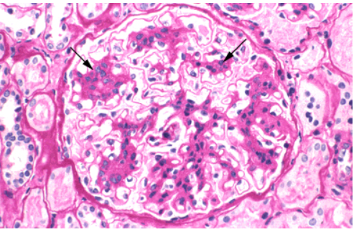

Slide 9
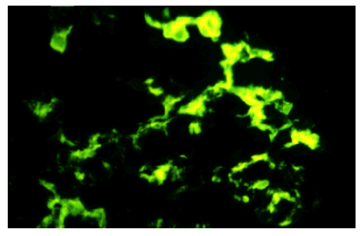

Slide 10
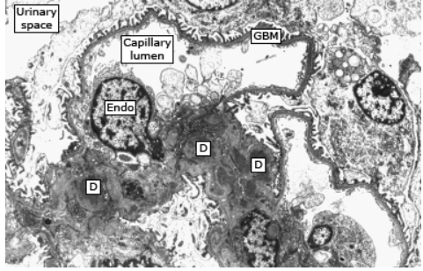

Slide 11
Oxford classification of IgAN — In 2009
Mesangial hypercellularity
Endocapillary hypercellularity –
Segmental glomerulosclerosis
Tubular atrophy/interstitial fibrosis :
Crescents
Biopsies with fewer than eight glomeruli should be considered of uncertain value for prognosis.

Slide 12
(IgAN) TRATAMIENTO
Tratamiento no farmacologico
Tratamiento farmacologico nefroproteccion o de soporte: Proteinuria
Pacientes de Alto Riesgo de Progresar a CKD (Risk assessment –
We score the patient's kidney biopsy using the Oxford classification of IgAN MEST-C score,
proteinuria ≥1 g/day despite at least three months of optimized supportive care),
Glucocorticoides Via oral por 6 meses
For patients who cannot tolerate or who do not wish to receive high-dose glucocorticoids, targeted-release budesonide (TRF-budesonide) or mycophenolate mofetil (MMF) is an alternative option.
Alternatively, the patient can be encouraged to participate in a clinical trial if feasible.
Contraindicado inmusupresion TFG menor de 30 ml minute.

Slide 13
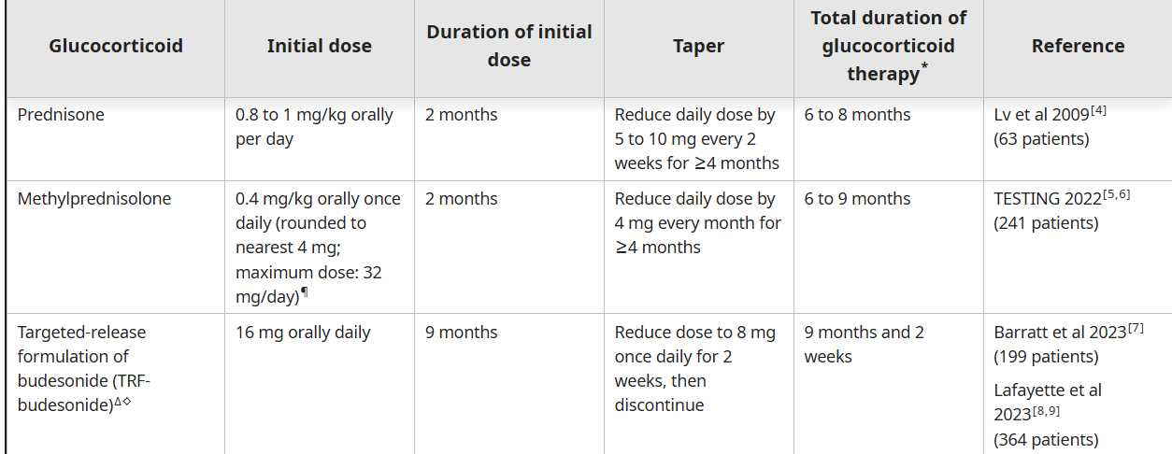
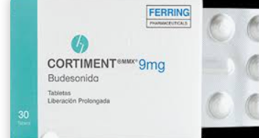

Slide 14
Indicaciones de Biopsia renal
A kidney biopsy may not be indicated in every patient suspected of having IgAN, depending upon their clinical presentation. As an example, a kidney biopsy is not usually performed for patients presenting with isolated hematuria (ie, without evidence of proteinuria or impaired kidney function), since establishing the diagnosis frequently does not alter the course of treatment in such patients. In such patients, a kidney biopsy is usually performed only if there are signs suggestive of more severe or progressive disease, such as persistent proteinuria of at least 500 mg per day or an elevated serum creatinine concentration

Slide 15
DIFFERENTIAL DIAGNOSIS IgA
Alport syndrome (also referred to as hereditary nephritis) LIGADA AL CROMOSOMA x O AUTOSOMICA d o r . MBG TFG HD Sordera: oculares Análisis genético confirmatorio de mutaciones en los genes COL4A3, COL4A4 o COL4A5.
Thin basement membrane
The diagnosis of any of these disorders can only be made by kidney biopsy,
or by inference in Alport syndrome if there is a family history of kidney failure with or without deafness,
or in thin basement membrane disease if approximately one-half of first-degree relatives have hematuria.

Slide 16
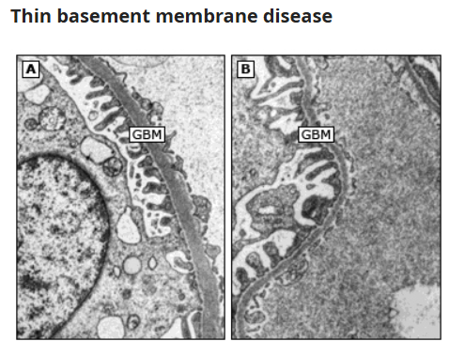

Slide 17
PSGN otro diagnostico Diferencial
Asintomatico o Hematuria macroscopica dsp de Infeccion VAS, ( interval de tiempo es mayor a 10 dias versus 5 dias GNF Iga ) o nefritico
Poststreptococcal glomerulonephritis (PSGN) is caused by prior infection with specific nephritogenic strains of group A beta-hemolytic streptococcus. and PSGN is dependent upon the site of infection: between one and three weeks following GAS pharyngitis and between three and six weeks following GAS skin infection
Fisiopatogenia; autoimmune activacion via alterna del complemento
Nephritogenic streptococcal antigens – There are two leading candidates for the putative streptococcal antigen(s) responsible for PSGN,
nephritis-associated plasmin receptor (NAPlr) and
streptococcal pyrogenic exotoxin B (SPE B)

Slide 18
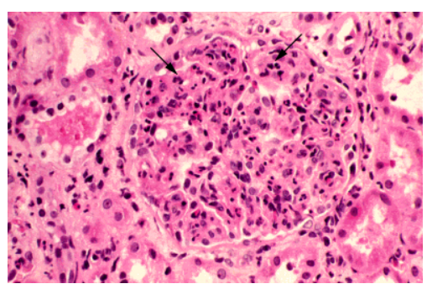

Slide 19
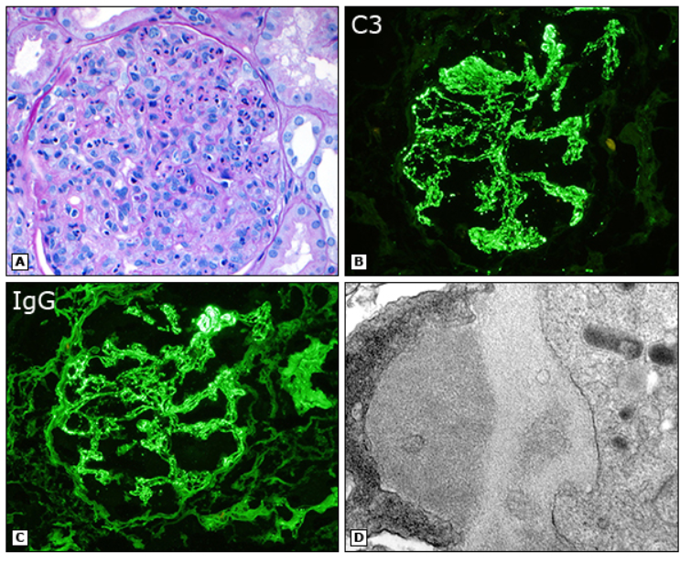

Slide 21
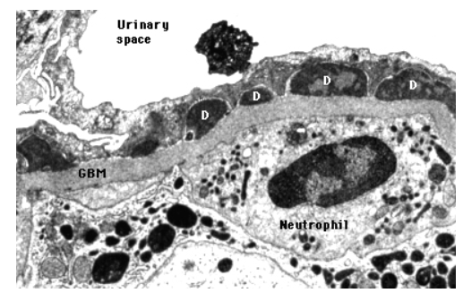

Slide 22
DIAGNOSTICO
Renal function — 20% tfg
Urinalysis and urinary protein excretion —
Complement — In approximately 90 percent of patients, C3 and CH50 (total complement activity) are significantly depressed in the first two weeks of the disease course . The C3 and CH50 return to normal within four to eight weeks after presentation.
Culture — Because PSGN presents weeks after an antecedent GAS infection, only approximately 25 percent of patients will have either a positive throat or skin culture [8]. In patients with impetigo, there is an increased likelihood of obtaining a positive skin culture
Serology — Elevated titers of antibodies to extracellular streptococcal products are evidence of a recent GAS infectionThe best markers for PSGN are serum antibody levels to NAPlr or SPEB/zSPEB, but these tests are rarely available [47,48].
The streptozyme test is not available clinically
The following antibodies can be measured as part of the evaluation:
●Anti-streptolysin (ASO)
●Anti-hyaluronidase (AHase)
●Anti-streptokinase (ASKase)
●Anti-nicotinamide-adenine dinucleotidase (anti-NAD)
●Anti-DNase B antibodies
After a pharyngeal infection, the ASO, anti-DNase B, anti-NAD, and AHase titers are commonly elevated.
In comparison, only the anti-DNase B and AHase titers are typically increased after a skin infection.
If only the ASO titer is used to screen for GAS infection, it may be falsely low or negative in patients with skin infections [49]. It remains a useful test in patients with PSGN due to GAS pharyngitis but in some cases, the rise in ASO titer may be blunted in patients with pharyngitis who have received antimicrobial therapy.

Slide 23
Recordar !!!!
Renal biopsy is not performed in most patients to confirm the diagnosis of PSGN, since the resolution of PSGN typically begins within one week of presentation
Glomerulopatia por C3 : patients with C3 glomerulopathy continue to have persistent urinary abnormalities and hypocomplementemia beyond four to six weeks and possibly a further elevation in serum creatinine. In contrast, patients with PSGN typically have resolution of their disease and a return of normal C3 and CH50 levels.

Slide 24
Purpura schonlein Henoch
Immunoglobulin A (IgA) vasculitis (IgAV; formerly Henoch-Schönlein purpura [HSP]) is the most common systemic vasculitis among children. 90% percent of cases occur in the pediatric age group.
In contrast to other forms of childhood systemic vasculitis, IgAV is usually self-limited, at least in children, and is characterized by a tetrad of clinical manifestations that vary in their presence and order of presentation:
●Palpable purpura (leukocytoclastic vasculitis) in patients with neither thrombocytopenia nor coagulopathy
●Arthralgia and/or arthritis
●Abdominal pain
●Kidney disease

Slide 25
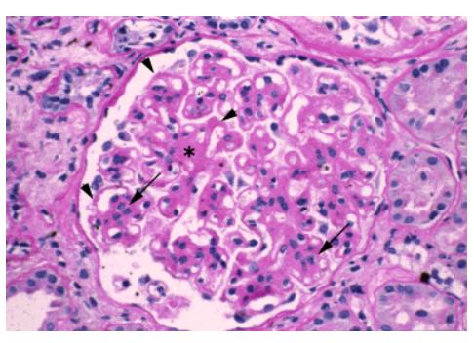
GNF. MEMBRANOPROLIFERATIVA Mesangiocapilar
TERMINO : patron histologico MO.

Slide 26
FISIOPATOGENIA
2 MECANISMO
MPGN inmuncomplejos/ Innumonoglobulinas / activación complemento INMUNO FLUORESCENCIA
MPGN: mediada por disregulacion complemento o activacion persistente de la via alterna del complemento.
INMUNOFLUORESCENCIA COMPLEMENTO

Slide 27
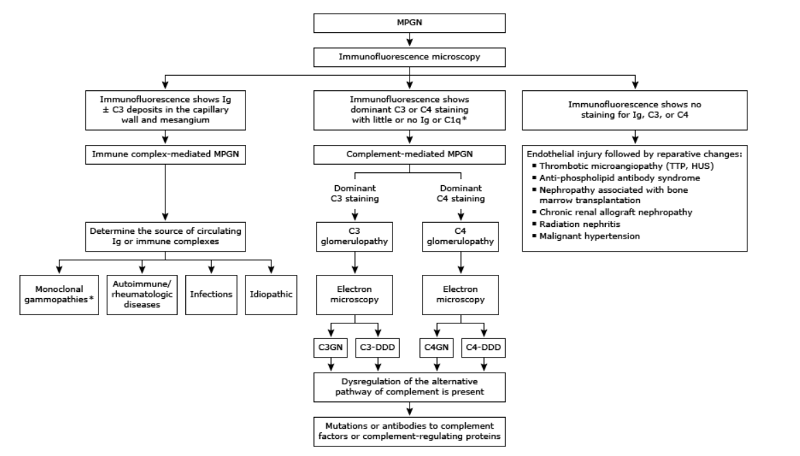
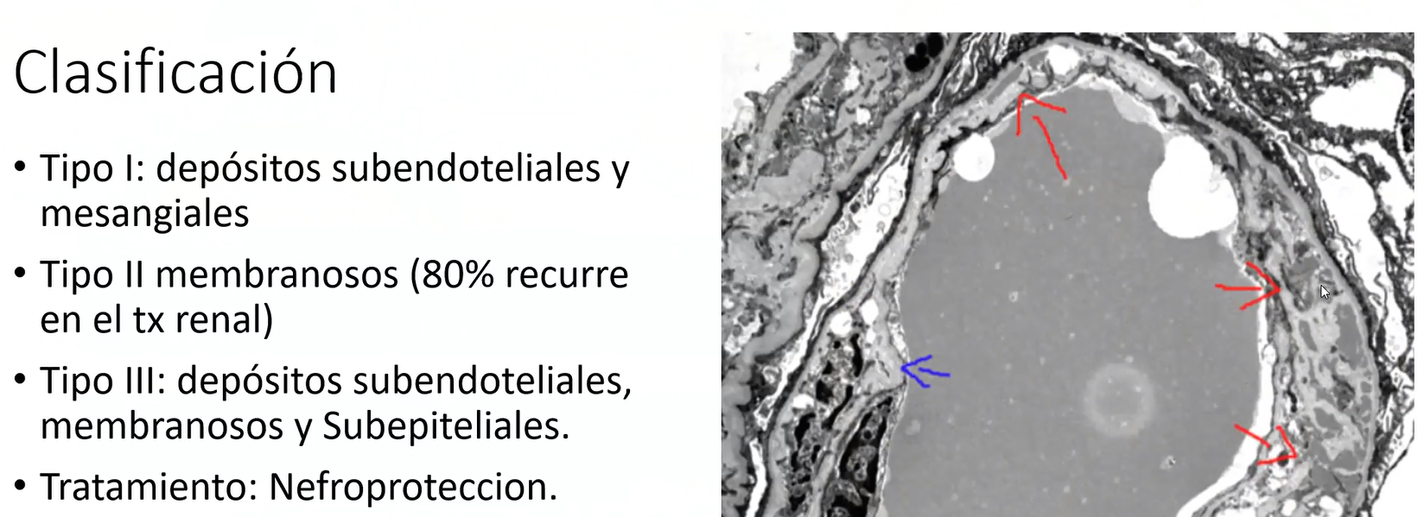

Slide 28
MPGN TRATAMIENTO
MMF is suggested as first-line therapy. Observational data showed that MMF decreased progression to kidney failure compared to other immunosuppressives. After MMF, the direction of treatment is not clear.
Because a complement-mediated disease, eculizumab has been used in a small number of patients with variable results. While eculizumab can be tried in patients who fail to respond mmF.

Slide 29
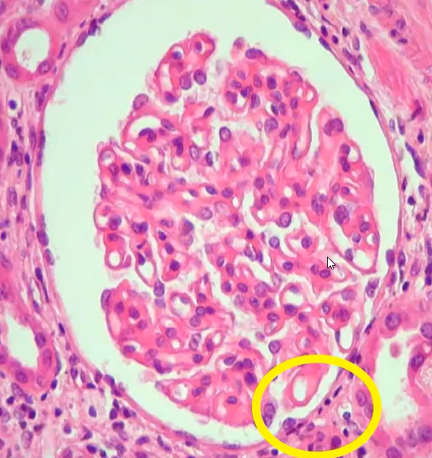
GNF. Membranosa
80-90% en el adulto. Masculino. Aparicion gradual.

Slide 30
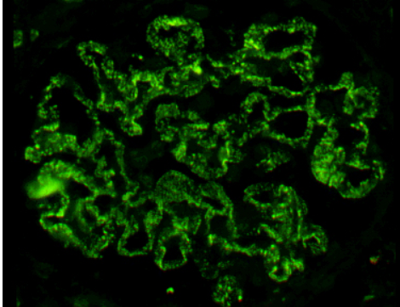

Slide 31
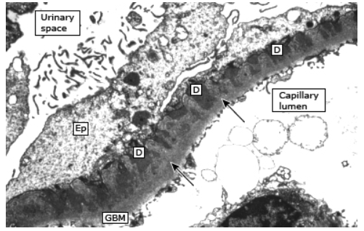

Slide 32
PATRON HISTOLOGICO
Caracteristica Histologica: MO, IF , ME.
Anti phospholipase A2 receptor (PLA2R) and, later, thrombospondin type-1 domain-containing 7A (THSD7A), two proteins expressed by the normal podocyte, established a prototype for "primary" disease

Slide 33
RECORDAR
Patients with positive anti-PLA2R serology (ELISA and IFA), normal kidney function, and no evidence of secondary causes of MN or diabetes mellitus may be diagnosed with primary PLA2R-associated MN without the need for a kidney biopsy.
However, a negative serological test for anti-PLA2R does not exclude a diagnosis of primary MN, as up to 20 percent of cases may be seronegative at presentation with nephrotic syndrome. According to manufacturer instructions, a positive signal at 1:10 in the IFA defines seropositivity. In the ELISA, a clear positive assay is represented by a titer above 20 RU/mL, whereas a titer in the 14 to 20 RU/mL range is considered borderline.

Slide 34
FENOTIPOS DE GNF MEMBRANOSA
Remission parcial
Remission espontanea
Sindrome Nefrotico
Progresion CKD

Slide 35
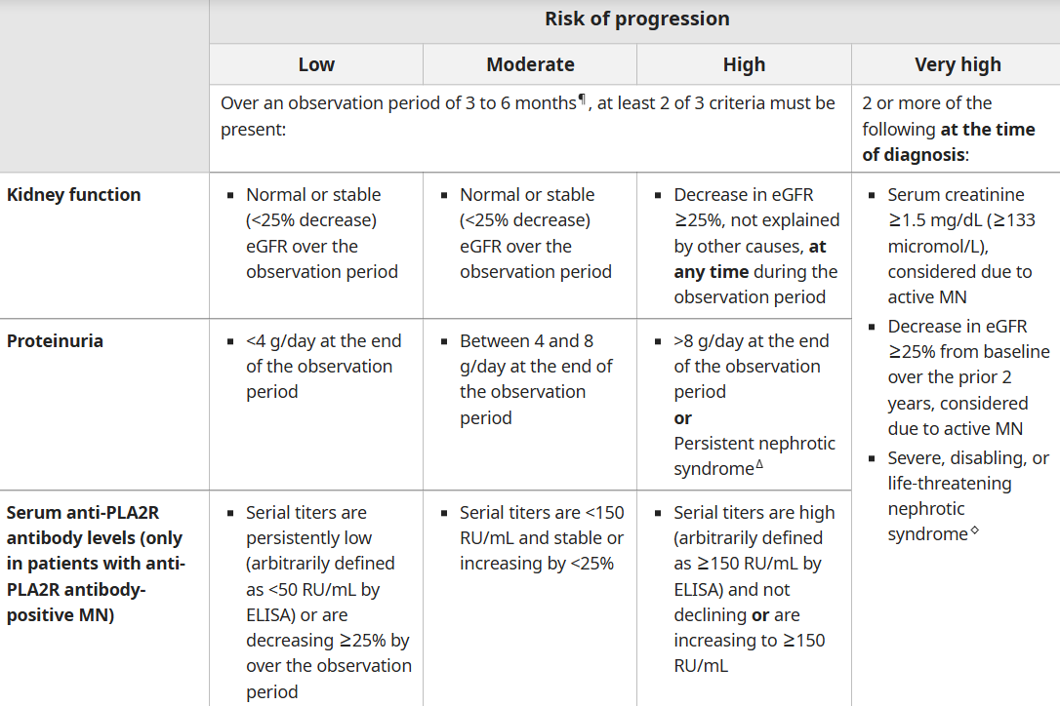

Slide 36
●Low risk of progression – Patients at low risk of progression do not require immunosuppressive therapy and can be managed with continued observation and general supportive measures only. Such patients generally have excellent long-term prognosis and often undergo spontaneous partial or complete remission.

Slide 37
●Moderate risk of progression – In patients who are at moderate risk of progression, our approach to initial therapy varies depending upon the course of disease during an initial three-to-six-month observation period with maximal general supportive measures (including renin-angiotensin system inhibition) (see 'Moderate risk of progression' above):
•In moderate-risk patients who show a progressive increase in proteinuria over the observation period, we recommend treatment with immunosuppressive therapy and continued general supportive measures, rather than continued general supportive measures alone (Grade 1B).
•In moderate-risk patients who show stable proteinuria over the observation period, we suggest immunosuppressive therapy and continued general supportive measures, rather than continued general supportive measures alone (Grade 2C). However, some clinicians would continue to withhold immunosuppressive therapy beyond six months in such patients if they are doing well, serum albumin is increasing, anti-PLA2R antibody levels (if initially positive) are low or decreasing, or if the patients are at high risk of having an adverse event with immunosuppressive therapy.
•In moderate-risk patients who show a progressive decline in proteinuria over the observation period, we withhold immunosuppression and continue general supportive measures.
•In most moderate-risk patients who require immunosuppressive therapy, we suggest rituximab rather than glucocorticoids plus cytotoxic therapy or a CNI (Grade 2C). If rituximab is unavailable, either combination therapy with glucocorticoids plus a cytotoxic agent or CNI monotherapy is a reasonable alternative. If cytotoxic therapy is chosen, we prefer cyclophosphamide over chlorambucil, since chlorambucil has more side effects. If a CNI is selected, either cyclosporine or tacrolimus is a reasonable choice. (See 'Rituximab' above and 'Cytotoxic therapy plus glucocorticoids' above and 'Calcineurin inhibitors' above.)

Slide 38
High or very high risk of progression – In patients who are at high or very high risk of progression, we recommend treatment with immunosuppressive therapy and continued general supportive measures, rather than continued general supportive measures alone (Grade 1B). The choice of immunosuppressive therapy depends upon how the patient is defined as high or very high risk (see 'High or very high risk of progression' above):
•In patients who are classified as high or very high risk and have stable kidney function, we suggest treatment with rituximab rather than cytotoxic therapy or other therapies (Grade 2C). However, a calcineurin inhibitor (CNI) is a reasonable alternative to rituximab in patients who are anti-phospholipase A2 receptor (PLA2R) antibody negative. (See 'Rituximab' above and 'Cytotoxic therapy plus glucocorticoids' above and 'Calcineurin inhibitors' above.)
•In patients who are classified as high or very high risk because of abnormal or declining kidney function at presentation or rapidly declining kidney function due to MN, we suggest combination treatment with glucocorticoids and a cytotoxic agent (preferably cyclophosphamide) rather than rituximab or other therapies (Grade 2C). In patients who wish to avoid cytotoxic therapy, treatment with rituximab may be a reasonable alternative.

